Slide 1
http://www.vidyanidhi.com/
ketkiacharya.net@gmail.com
REACT JS
Ketki Acharya
From: SM VITA ATC of CDAC
9769201036
ketkiacharya.net@gmail.com

Slide 2
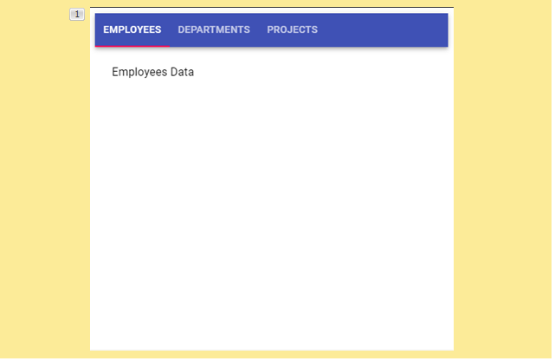
Routing
we know that Components are the basic building blocks of our react applications. We will be developing multiple components as Part of working on any Project, like how we have created Employee Component, Department Component and Project Components.
When we create multiple components, we don’t show all these components together to the User.
we change what the user sees by showing or hiding portions of the display that correspond to particular components based on User Activities.
As like in this Example, we will show Employee Component when we are in Employee Tab, When we Click on Department Tab, we show the Contents of Department Component and When we Click on Project Tab, we will display the contents of Project Component.
To implement this kind of navigation within the single page of our application, we use the concept of Routing.
Routing enables navigation from one view to the next view (within the same page) as users perform different tasks.

Slide 3
A <BrowserRouter> stores the current location in the browser's address bar using clean URLs and navigates using the browser's built-in history stack.
<Router> is the low-level interface that is shared by all router components (like <BrowserRouter> and <StaticRouter>). In terms of React, <Router> is a context provider that supplies routing information to the rest of the app.
You probably never need to render a <Router> manually. Instead, you should use one of the higher-level routers depending on your environment. You only ever need one router in a given app.
The <Router basename> prop may be used to make all routes and links in your app relative to a "base" portion of the URL pathname that they all share. This is useful when rendering only a portion of a larger app with React Router or when your app has multiple entry points. Basenames are not case-sensitive.
<Routes>
Rendered anywhere in the app, <Routes> will match a set of child routes from the current location.
Route are perhaps the most important part of a React Router app. They couple URL segments to components, data loading and data mutations.
An <Outlet> should be used in parent route elements to render their child route elements. This allows nested UI to show up when child routes are rendered. If the parent route matched exactly, it will render a child index route or nothing if there is no index route.
A <Link> is an element that lets the user navigate to another page by clicking or tapping on it. In react-router-dom, a <Link> renders an accessible <a> element with a real href that points to the resource it's linking to. This means that things like right-clicking a <Link> work as you'd expect.

Slide 4
<Link>
Natively, web pages are required to be linked (hyperlink) together for navigation. This navigation involves moving from one web page to another web page in the same domain (website) or a different domain on the web.
However, navigation on the web does not only involve moving from one web page to another but also moving from one section (hash) to another on the same web page.
Natively, navigating using the <a> tag requires the entire web page to reload. This might lead to slow navigation depending on the amount of content on the web page and other asynchronous request the browser has to do in other to fetch third-party resources like APIs.
The <Link> Component in React Router is built to handle routing (navigation) on the client side and prevent the web page from reloading for easy navigation.

Slide 5
to
The to props (property) is equivalent to the href attribute of the <a> tag. The to props is used to handle routing, by specifying the relative or absolute path the <Link> should navigate to when a user clicks on it.
// Link Component
<Link to="/">Home</Link>
// HTML equivalent
<a href="home"></a>
Props
Props in react are referred to as properties, the <Link> Component comes with some defined props that can be applied to the <Link> Component the same way HTML attribute is applied to HTML tags.
This is very useful when you want to apply a specific function on how the <Link> Component should behave when a user clicks on it.
The <Link> Component props include.
to
reloadDocument
reloadDocument
Just as the name implied, the reloadDocument props reload the entire web page when a user clicks on the <Link> Component. This is the native behavior of the <a> tag.
To specify the reloadDocument props apply it on the <Link> Component like so 👇
<Link to="/" reloadDocument> Home </Link>

Slide 6
npm install react-router-dom@6
Root
App
Home Contactus Listproduct
import {Outlet,Link } from "react-router-dom";
Index
Outlet
const root = ReactDOM.createRoot(document.getElementById('root'));
root.render(
<BrowserRouter>
<Routes>
<Route path="/" element={<App />}>
<Route path="Home" element={<Home />} />
<Route path="Contactus" element={<Contactus />} />
<Route path="Listproduct" element={<Listproduct />} />
<Route path="Example" element={<Example/>} />
<Route path="*" element={<Nopage />} />
</Route>
</Routes>
</BrowserRouter>
import { BrowserRouter, Routes, Route } from "react-router-dom";

Slide 7
Index.js
import React from 'react';
import ReactDOM from 'react-dom/client';
import './index.css';
import App from './App';
import reportWebVitals from './reportWebVitals';
import Nopage from './Nopage';
import { BrowserRouter, Routes, Route } from "react-router-dom";
import Home from './Home';
import Contactus from './Contactus';
import ListEmployee from './ListEmployee';
const root = ReactDOM.createRoot(document.getElementById('root'));
root.render(
<BrowserRouter>
<Routes>
<Route path="/" element={<App />} />
<Route path="Home" element={<Home />} />
<Route path="Contactus" element={<Contactus />} />
<Route path="ListEmployee" element={<ListEmployee />} />
<Route path="*" element={<Nopage />} />
</Routes>
</BrowserRouter>
);
// If you want to start measuring performance in your app, pass a function
// to log results (for example: reportWebVitals(console.log))
// or send to an analytics endpoint. Learn more: https://bit.ly/CRA-vitals
reportWebVitals();
root
Sibling
ListEmployee
Home
Contactus
App

Slide 8
Index.js
import React from 'react';
import ReactDOM from 'react-dom/client';
import './index.css';
import App from './App';
import reportWebVitals from './reportWebVitals';
import Nopage from './Nopage';
import { BrowserRouter, Routes, Route } from "react-router-dom";
import Home from './Home';
import Contactus from './Contactus';
import ListEmployee from './ListEmployee';
const root = ReactDOM.createRoot(document.getElementById('root'));
root.render(
<BrowserRouter>
<Routes>
<Route path="/" element={<App />} >
<Route path="Home" element={<Home />} />
<Route path="Contactus" element={<Contactus />} />
<Route path="ListEmployee" element={<ListEmployee />} />
<Route path="*" element={<Nopage />} />
</Route>
</Routes>
</BrowserRouter>
);
// If you want to start measuring performance in your app, pass a function
// to log results (for example: reportWebVitals(console.log))
// or send to an analytics endpoint. Learn more: https://bit.ly/CRA-vitals
reportWebVitals();
root
App
Outlet
ListEmployee
Home
Contactus

Slide 9
import React from 'react';
import ReactDOM from 'react-dom/client';
import './index.css';
import App from './App';
import reportWebVitals from './reportWebVitals';
import { BrowserRouter,Routes,Route } from 'react-router-dom';
import Home from "./Home";
import Listproduct from "./Listproduct";
import Contactus from "./Contactus"
import Example from "./Example";
import Nopage from "./Nopage";
const root = ReactDOM.createRoot(document.getElementById('root'));
root.render(
<BrowserRouter>
<Routes>
<Route path="/" element={<App />}>
<Route path="/" element={<Home />}/>
<Route path="Home" element={<Home />} />
<Route path="Contactus" element={<Contactus />} />
<Route path="Listproduct" element={<Listproduct />} />
<Route path="Example" element={<Example />} />
<Route path="*" element={<Nopage />} />
</Route>
</Routes>
</BrowserRouter>
);
// If you want to start measuring performance in your app, pass a function
// to log results (for example: reportWebVitals(console.log))
// or send to an analytics endpoint. Learn more: https://bit.ly/CRA-vitals
reportWebVitals();

Slide 10
import { Outlet, Link} from "react-router-dom"
function App() {
return (
<div>
<nav>
<ul>
<li> <Link to="/Home">Home</Link> </li>
<li> <Link to="/Contactus">Contactus</Link> </li>
<li> <Link to="/Listproduct">Listproduct</Link> </li>
</ul>
</nav>
<Outlet></Outlet>
</div>
);
}
export default App;

Slide 11
export default function Contactus()
{
return (<address>Vita.net@gmail.com</address>)
}
export default function Listproduct()
{
return (<h1>Listproduct</h1>)
}
export default function Home()
{
return (<h1>This is Home Page</h1>)
}

Slide 12
Read All Employee
import { Outlet, Link } from "react-router-dom"
function App() {
return (
<div>
<nav>
<ul>
<li> <Link to="/Home">Home</Link> </li>
<li> <Link to="/Contactus">Contactus</Link> </li>
<li> <Link to="/Listemployee">Listemployee</Link> </li>
</ul>
</nav>
<Outlet></Outlet>
</div>
);
}
export default App;

Slide 13
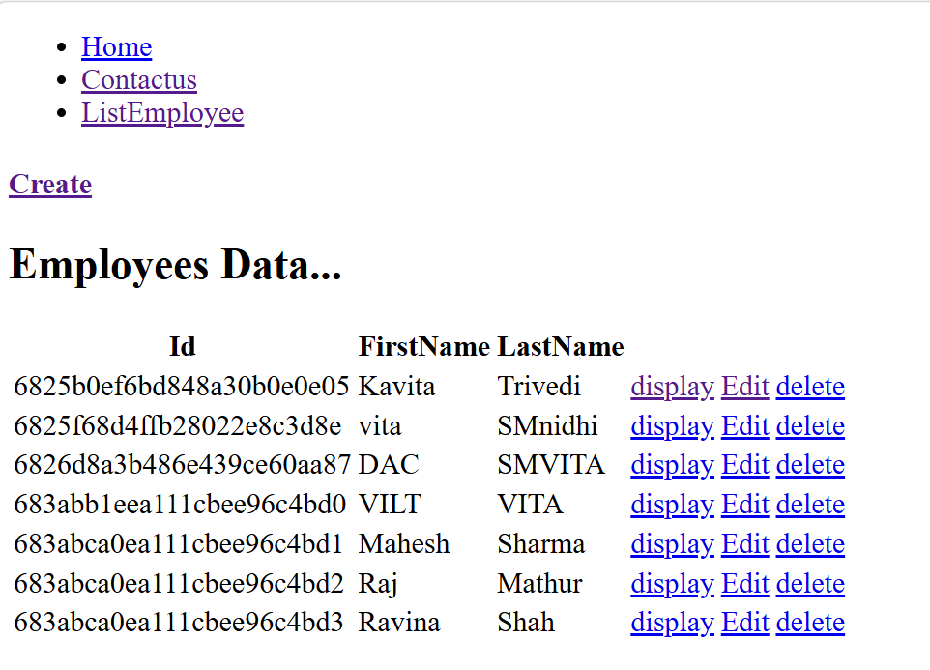

Slide 14
import React from 'react';
import ReactDOM from 'react-dom/client';
import './index.css';
import App from './App';
import reportWebVitals from './reportWebVitals';
import { BrowserRouter,Routes,Route } from 'react-router-dom';
import Home from "./Home";
import Listemployee from './Listemployee';
import Contactus from "./Contactus"
import Example from "./Example";
import Nopage from "./Nopage";
import Createemp from './Createemp';
const root = ReactDOM.createRoot(document.getElementById('root'));
root.render(
<BrowserRouter>
<Routes>
<Route path="/" element={<App />}>
<Route path="/" element={<Home />}/>
<Route path="Home" element={<Home />} />
<Route path="Contactus" element={<Contactus />} />
<Route path="Listemployee" element={<Listemployee />} />
<Route path="Example" element={<Example />} />
<Route path="Create" element={<Createemp />} />
<Route path="*" element={<Nopage />} />
</Route>
</Routes>
</BrowserRouter>
);
reportWebVitals();
Index.js
React Router is a standard library for routing in React. It enables navigation between views from different components in a React application, allows the browser URL to be changed, and keeps the UI in sync with the URL.
routes
An array of Route objects with nested routes on the children property.

Slide 15
import React from 'react';
import {Link} from "react-router-dom"
import { useState, useEffect } from "react";
function ListEmployee() {
const [employees, setEmployee] = useState([]);
useEffect(() => {
fetch("http://localhost:8081/person")
.then(res => res.json())
.then((result) => { setEmployee(result); }
);
}, []);
return (
<div>
<h4><Link to="/create">Create</Link></h4>
<h2>Employees Data...</h2>
<table> <thead>
<tr>
<th>Id</th>
<th>Name</th>
<th>LastName</th>
</tr>
</thead>
<tbody>
{employees.map(emp =>(
<tr key={emp._id}>
<td>{emp._id}</td>
<td>{emp.firstname}</td>
<td>{emp.lastname}</td>
<td> <Link to={'/emp/' + emp.id}>display</a></td>
<td> <Link to={'/empup/' + emp.id}>Edit</a></td>
<td> <Link to={'/empdel/' + emp.id}>delete</a></td>
</tr>
))
}
</tbody> </table>
</div>
);
}
export default ListEmployee;
Alternate➔`/empup/${emp.id}`
Map
[…….]
emp =>((emp)=>{id:1.name:’raj’,lastname:shah}

Slide 16
If you want to transfer data to other component (TableRow)
employees .map((person, i) => <TableRow key = {i}
data = {person} />)}

Slide 17
Best Practices
import { useState, useEffect } from "react";
import { Link } from "react-router-dom"
function Listemployee() {
const [employees, setEmployees] = useState([]);
const [loading, setLoading] = useState(true);
const [error, setError] = useState(null);
console.log("Rendering Listemployee component");
useEffect(() => {
let isMounted = true; // track if component is still mounted
const controller = new AbortController(); // for cancellation
const signal = controller.signal;
const fetchEmployees = async () => {
try {
const response = await fetch("http://localhost:8081/person", { signal });
if (!response.ok) {
throw new Error(`HTTP error! status: ${response.status}`);
}
const data = await response.json();
if (isMounted) {
setEmployees(data);
}
} catch (err) {
if (isMounted && err.name !== "AbortError") {
setError(err.message);
}
} finally {
if (isMounted) {
setLoading(false);
}
}
};
setTimeout(fetchEmployees, 1000); // simulate network delay
// Cleanup function
return () => {
isMounted = false;
controller.abort(); // cancel fetch if component unmounts
};
}, []);
if (error) return <p>Error: {error}</p>;
return (
<div>
{loading ? <p>Loading...</p> : null }
new AbortController(); → the object that can trigger cancellation.
• signal → a special object tied to that controller, which you pass into async operations (like ).
Prevents memory leaks: avoids updating state after a component unmounts.
• Stops race conditions: if multiple fetches overlap, you can cancel the old one.
• Improves performance: no wasted network calls.
So in short:
is the remote control, and is the wire you plug into your async task. Calling cuts the wire, and the task stops immediately.

Slide 18
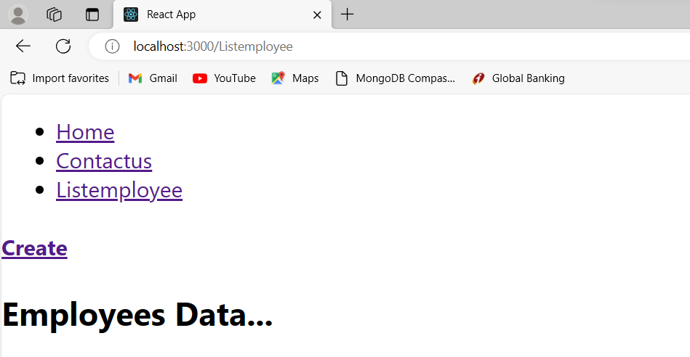
<h4><Link to="/create">Create</Link></h4>
<Route path="Create" element={<Createemp />} />

Slide 19
POST Employee
import { useState} from "react";
import { useNavigate} from "react-router-dom"
export default function Createemp() {
const [employee, setEmployee] = useState({});
let navigate = useNavigate();
const handleChange = (event) => {
const name = event.target.name;
const value = event.target.value;
setEmployee(values => ({ ...values, [name]: value }))
}
const handleSubmit = (event) => {
let demo = JSON.stringify(employee);
fetch("http://localhost:8081/person", {
method: 'POST',
headers: { 'Content-type': 'application/json' },
body: demo
}).then(r => { console.log(r) })
event.preventDefault();
navigate('/');
}
firstname:raj
lastname:shah
return (
<form onSubmit={handleSubmit}>
<label>name:</label>
<input
type="text"
name="firstname"
onChange={handleChange}
/>
<br /><label>Email:</label>
<input
type="text"
name="lastname"
onChange={handleChange}
/>
<br />
<input type="submit" />
</form>
);
}

Slide 20
Create a Clone of an Object
We can create a cloned instance of an object using the spread syntax like this:
const user = {
'name': 'Alex',
'address': '15th Park Avenue',
'age': 43
}
const clone = {...user} // Output, {name: "Alex", address: "15th Park Avenue", age: 43}
clone === user; // Output, false
You can alternatively use object.assign() to create a clone of an object. However, the spread syntax is much more precise and much shorter.
The spread syntax performs a shallow copy of the object. This means that none of the nested object instances are cloned.
Add Properties to Objects
We can add a new property (key-value pair) to the object using the spread syntax. Note that the actual object never gets changed. The new property gets added to the cloned object.
In the example below, we are adding a new property (salary) using the spread syntax.
const user = {
'name': 'Alex',
'address': '15th Park Avenue',
'age': 43
}
// Add a new property salary
const updatedUser = {...user, salary:12345}; // {name: "Alex", address: "15th Park Avenue", age: 43, salary: 12345}
// Original object is unchanged
console.log(user); // {name: "Alex", address: "15th Park Avenue", age: 43}
{ 'name': 'Alex',
'address': '15th Park Avenue',
'age': 43
}
user
clone
{ 'name': 'Alex',
'address': '15th Park Avenue',
'age': 43
}
Update Properties
We can also update an existing property value using the spread syntax. Like the add operation, the update takes place on the object's cloned instance, not on the actual object. In the
example below, we are updating the value of the age property:
const user = { 'name': 'Alex', 'address': '15th Park Avenue', 'age': 43}
const updatedUser = {...user, age:56}; // {name: "Alex", address: "15th Park Avenue", age: 56}
console.log(user); // {name: "Alex", address: "15th Park Avenue", age: 43}

Slide 21
It’s a similar situation with arrays. Except that instead of spreading over keys and values, the operator spreads indexes and values. Unlike object spread, where you won’t have duplicate properties because that’s just how JavaScript objects work (you can’t have an object with two name properties), with arrays you may end up with duplicate values, if you plan to implement something similar to our object example.
This means that the code below will result in you having an array with duplicate elements.
const numbers1 = [1, 2, 3, 4, 5];
const numbers2 = [ ...numbers 1, 1, 2, 6,7,8]; // this will be [1, 2, 3, 4, 5, 1, 2, 6, 7, 8]
Think of it as a replacement for Array.prototype.concat.

Slide 22
<script>
function go(){
data={employee:{code:'',"name" :""}};
const name = event.target.name;
const value = event.target.value;;
data= { employee:{
...data.employee,
[name]: value,
}
};
console.log(data.employee)
}
</script>
<form>
<input name="code" onchange="go()"/>
<input name="name" onchange="go()"/>
<button>click</button>
</form>
Code:101,
Name:”vita”
{Code:101,
Name:”vita”
}
For(let pp in data.employee)
{
Console.log(data.employee[pp])
}

Slide 23
import { useState } from "react";
import { useNavigate } from "react-router-dom";
export default function Createemp() {
const [employee, setEmployee] = useState({ firstname: "", lastname: ""});
const [isSubmitting, setIsSubmitting] = useState(false);
const navigate = useNavigate();
const handleChange = (event) => {
const { name, value } = event.target;
setEmployee((prev) => ({ ...prev, [name]: value }));
};
const handleSubmit = async (event) => {
event.preventDefault();
if (!employee.firstname || !employee.lastname) {
alert("firstName and lastname are required");
return;
}
setIsSubmitting(true);
try {
const response = await fetch("http://localhost:8081/person", {
method: "POST",
headers: { "Content-Type": "application/json" },
body: JSON.stringify(employee),
});
Best Practice
if (!response.ok)
throw new Error ( "Failed to create employee");
navigate("/");
} catch (error) {
console.error(error);
alert("Something went wrong!");
} finally {
setIsSubmitting(false);
}
};
GetAll Employee

Slide 24
return (
<form onSubmit={handleSubmit}>
<input name= "firstname" value={employee.firstname} onChange={handleChange} placeholder= "firstName" />
<input name= "lastname" value={employee.lastname} onChange={handleChange} placeholder=" lastname" />
<button type="submit" disabled={isSubmitting}>
{isSubmitting ? "Submitting..." : "Create Employee"}
</button>
</form>
);
}

Slide 25
Get one employee
Localhost:3000/emp/2
Add in route table
<Route path="emp/:id" element={<Employee />} />

Slide 26
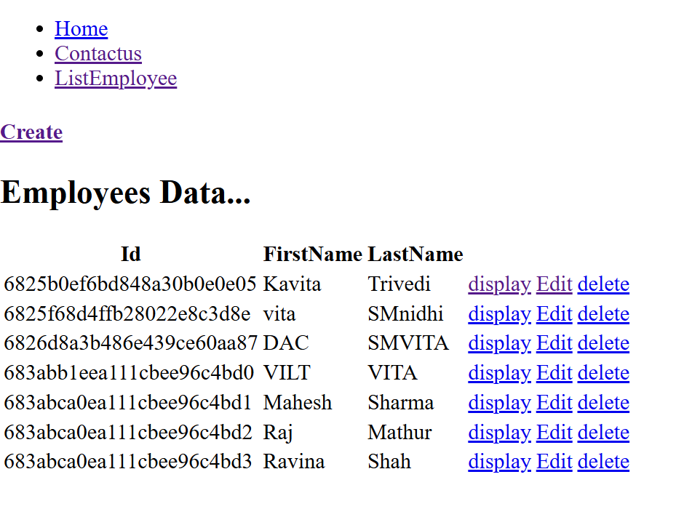

Slide 27
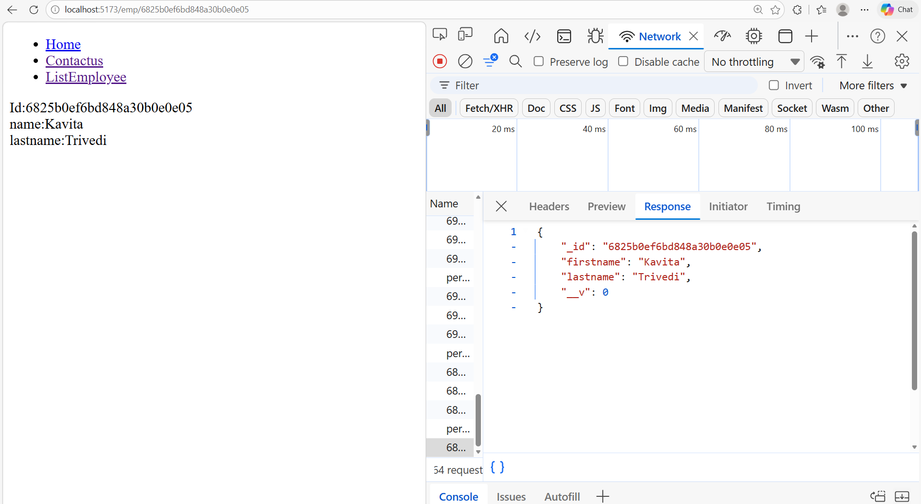

Slide 28
import React from 'react';
import { useState, useEffect } from "react";
import { useParams } from "react-router-dom"
export function Employee() {
const [employee, setEmployee] = useState({});
const { id } = useParams()
console.log(useParams())
useEffect(() => {
fetch("http://localhost:8081/person" + id)
.then(res => res.json())
.then((result) => { setEmployee(result); }
);
}, [id]);
return (
<div><label>Id:</label>
{employee.id}<br />
<label>name:</label>
{employee.firstname}<br />
<label>lastname:</label>
{employee.lastname}<br />
</div>
);
}
export default Employee;
Localhost:3000/emp/2
{id:2}

Slide 29
import React, { useState, useEffect } from "react";
import { useParams } from "react-router-dom";
export function Employee() {
const [employee, setEmployee] = useState({ name: "", email: "", departmentId: "" });
const [loading, setLoading] = useState(true);
const { id } = useParams();
useEffect(() => {
const controller = new AbortController();
const fetchEmployee = async () => {
try {
const res = await fetch(`http://localhost:8081/person/${id}`, {
signal: controller.signal,
});
if (!res.ok) throw new Error("Failed to fetch employee");
const data = await res.json();
setEmployee(data);
} catch (error) {
if (error.name !== "AbortError") {
console.error(error);
alert("Error fetching employee details");
}
} finally {
setLoading(false);
}
};
fetchEmployee();
// Cleanup: abort fetch if component unmounts
return () => controller.abort();
}, [id]);
Best Prctice
Display one record

Slide 30
if (loading) return <p>Loading employee...</p>;
return (
<div>
<h2>Employee Details</h2>
<p><strong>Name:</strong> {employee.firstname}</p>
<p><strong>Email:</strong> {employee.lastname}</p>
</div>
);
}

Slide 31
Update
Localhost:3000/empup/2
<Route path="empup/:id" element={<Employeeup />} />

Slide 32
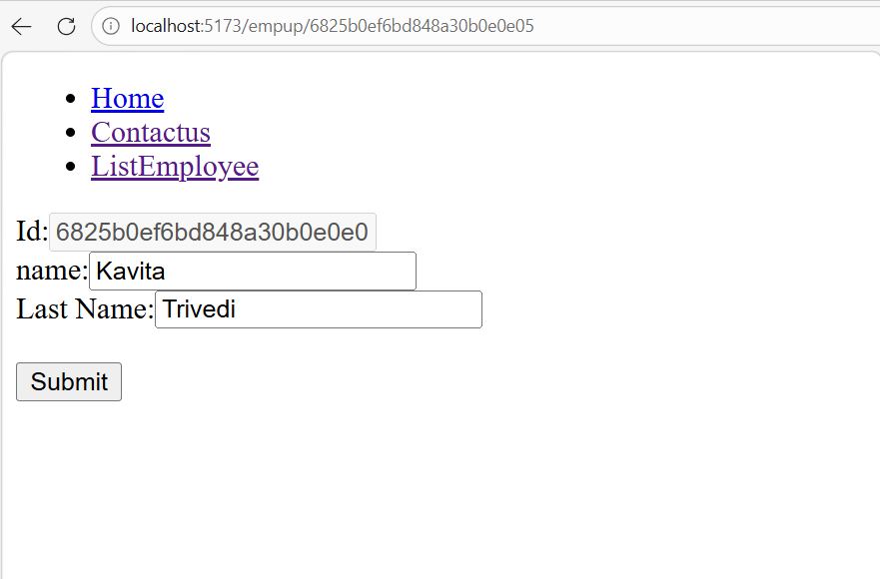

Slide 33
return (
<form onSubmit={handleSubmit}>
<label>Id:</label>
<input
type="text"
name="id"
value={employee?._id ?? ""}
disabled={true}
onChange={handleChange}
/>
<br /> <label>name:</label>
<input
type="text"
name=“firstname"
value={employee?.firstname ?? ""}
onChange={handleChange}
/>
<br /> <label>Email:</label>
<input
type="text"
name=“lastname"
value={employee?.lastname ?? ""}
onChange={handleChange}
/>
<br />
<input type="submit" />
</form>
);
} export default Employeeup;
import { useState, useEffect } from "react";
import { useNavigate, useParams } from "react-router-dom“
function Employeeup() {
const [employee, setEmployee] = useState({});
const { id } = useParams();
let navigate = useNavigate();
useEffect(() => {
fetch("http://localhost:8081/person" + id)
.then(res => res.json())
.then((result) => {
setEmployee(result);
}
).catch((e)=>console.log(e));
}, []);
const handleChange = (event) => {
const name = event.target.name;
const value = event.target.value;
setEmployee(values => ({ ...values, [name]: value }))
}
const handleSubmit = (event) => {
let demo = JSON.stringify(employee);
fetch(" http://localhost:8081/person/" + id, {
method: 'PUT',
headers: { 'Content-type': 'application/json' },
body: demo
}).then(r => { console.log(r) })
event.preventDefault();
navigate('/');
}
firstname:raj
lastname:Shah

Slide 34
import { useState, useEffect } from "react";
import { useNavigate, useParams } from "react-router-dom";
export function Employeeup() {
const [employee, setEmployee] = useState({ id: "", name: "", email: "", departmentId: "" });
const [loading, setLoading] = useState(true);
const { id } = useParams();
const navigate = useNavigate();
// Fetch employee details
useEffect(() => {
const controller = new AbortController();
const fetchEmployee = async () => {
try {
const res = await fetch(`http://localhost:8081/person/${id}`, {
signal: controller.signal,
});
if (!res.ok) throw new Error(`Failed to fetch employee: ${res.status}`);
const data = await res.json();
setEmployee(data);
} catch (error) {
if (error.name !== "AbortError") {
console.error(error);
alert("Error fetching employee details");
}
} finally {
setLoading(false);
}
};
fetchEmployee();
// Cleanup: abort fetch if component unmounts
return () => controller.abort();
}, [id]);
// Handle input changes
const handleChange = (event) => {
const { name, value } = event.target;
setEmployee((values) => ({ ...values, [name]: value }));
};
// Handle form submit
const handleSubmit = async (event) => {
event.preventDefault();
try {
const response = await fetch(`https://localhost:8081/person/${id}`, {
method: "PUT",
headers: { "Content-Type": "application/json" },
body: JSON.stringify(employee),
});
if (!response.ok) throw new Error(`Failed to update employee: ${response.status}`);
alert("Employee updated successfully");
navigate("/");
} catch (error) {
console.error(error);
alert("Error updating employee");
}
};
if (loading) {
return <p>Loading employee details...</p>;
}
Best Practice
PUT

Slide 35
return (
<form onSubmit={handleSubmit}>
<label>Id:</label>
<input
type="text"
name="id"
value={employee?._id ?? ""}
disabled={true}
onChange={handleChange}
/>
<br />
<label>Name:</label>
<input
type="text"
name= "firstname"
value={employee?.firstname ?? ""}
onChange={handleChange}
/>
<br />
<label>Email:</label>
<input
type="text"
name= "lastname"
value={employee?.lastname ?? ""}
onChange={handleChange}
/>
<br />
<input type="submit" value="Update Employee" />
</form>
); } export default Employeeup;

Slide 36
Delete
Localhost:3000/emdel/2
<Route path="empdel/:id" element={<Employeedel />} />

Slide 37
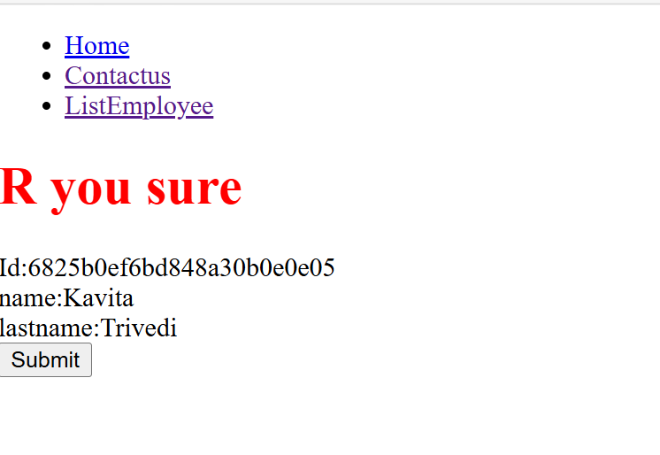

Slide 38
import React from 'react';
import { useState, useEffect } from "react";
import { useParams,useNavigate } from "react-router-dom"
export function Employeedel() {
const [employee, setEmployee] = useState({});
const { id } = useParams()
const navigate= useNavigate();
useEffect(() => {
fetch("" + id)
.then((res) =>{ res.json()
})
.then((result) => { setEmployee(result); }
);
}, []);
const handeldel = (event) => {
fetch("http://localhost:8081/person/" + id, {
method: 'Delete'
})
.then(res => res)
.then((result) => {
console.log(result)
});
event.preventDefault();
navigate('/');
}
return (
<div>
<h1 style={{ color:'red' }}>R you sure</h1>
<label>Id:</label>
{employee._id}<br />
<label>name:</label>
{employee.firstname}<br />
<label>Lastname:</label>
{employee.lastname}<br />
<form onSubmit={handeldel}>
<input type="submit" />
</form>
</div>
);
}
export default Employeedel;

Slide 39
import React, { useState, useEffect } from "react";
import { useParams, useNavigate } from "react-router-dom";
export function Employeedel() {
const [employee, setEmployee] = useState({ name: "", email: "", department: "" });
const [loading, setLoading] = useState(true);
const { id } = useParams();
const navigate = useNavigate();
// Fetch employee details
useEffect(() => {
const controller = new AbortController();
const fetchEmployee = async () => {
try {
const res = awaitn fetch(`https://localhost:8081/person/${id}`, {
signal: controller.signal,
});
if (!res.ok) throw new Error("Failed to fetch employee");
const data = await res.json();
setEmployee(data);
}
Best Practice
Delete

Slide 40
catch (error) {
if (error.name !== "AbortError") {
console.error(error);
alert("Error fetching employee details");
}
} finally {
setLoading(false);
}
};
fetchEmployee();
// Cleanup: abort fetch if component unmounts
return () => controller.abort();
}, [id]);
const handleDelete = async (event) => {
event.preventDefault();
const confirmDelete = window.confirm("Are you sure you want to delete this employee?");
if (!confirmDelete) return;
try {
const response = await fetch(`http://localhost:8081/person/${id}`, {
method: "DELETE",
});
if (!response.ok) throw new Error("Failed to delete employee");
alert("Employee deleted successfully");
navigate("/");
} catch (error) {
console.error(error);
alert("Error deleting employee");
}
};

Slide 41
return (
<div>
{loading ? <p>Loading...</p> : null }
<h2>Delete Employee</h2>
<p>
<strong>Name:</strong> {employee.firstname} <br />
<strong>Lastname:</strong> {employee.lastname} <br />
</p>
<button onClick={handleDelete}>Delete</button>
<button onClick={() => navigate("/")}>Cancel</button>
</div>

Slide 42
import { useState } from "react";
import {Outlet,Link, useNavigate } from "react-router-dom";
function App() {
const [isloggedin,setLoggedin]=useState(null);
const [readval,setVal]=useState(" ");
const handeldata=(event)=>{
setVal(event.target.value);
};
const navigate=useNavigate();
const check= (event)=>{
if (event.target.value==="LoggedIn"){
const data={readval};
sessionStorage.setItem("key",JSON.stringify(data))
setVal(" ");
setLoggedin(true)
}
else
{
sessionStorage.setItem("key","")
setLoggedin(false)
//navigate("/");
}
}
return (
<div>
<nav>
<ul>
<li> <Link to="/Home">Home</Link> </li>
<li> <Link to="/Contactus">Contactus</Link> </li>
<li> <Link to="/Listproduct">Listproduct</Link> </li>
</ul>
</nav>
<span><input type="text" value={readval} onInput={handeldata}/></span>
{isloggedin?
<button onClick={check} value="LoggedOut">LoggedOut</button>
:
<button onClick={check} value="LoggedIn">LoggedIn</button>
}
<Outlet />
</div>
);
}
export default App;

Slide 43
import React from 'react';
import { useState, useEffect } from "react";
import { useNavigate } from 'react-router-dom';
export function Listproduct(props) {
const [products, setProduct] = useState([]);
const chks=sessionStorage.getItem("key");
let navigate = useNavigate();
useEffect(() => {
if(chks==="")
{
navigate("/");
},[chks,navigate])
useEffect(() => {
fetch("https://localhost:44370/api/products/")
.then(res => res.json())
.then((result) => { setProduct(result); }
);
}, []);
return (
<div>
<h2>Employees Data...</h2>
;
<table>
<thead>
<tr>
<th>productId</th>
<th>Name</th>
<th>category</th>
<th>Color</th>
<th>unitPrice</th>
<th>availableQuantity</th>
</tr>
</thead>
<tbody>
{products.map(emp => (
<tr key={emp.productId}>
<td>{emp.productId}</td>
<td>{emp.name}</td>
<td>{emp.category}</td>
<td>{emp.color}</td>
<td>{emp.unitPrice}</td>
<td>{emp.availableQuantity}</td>
<td><a href= {"/editemp/"+emp.productId}>Edit</a></td>
<td><a href= {"/dispemp/"+emp.productId}>Display</a></td>
<td><a href= {"/deleteemp/"+emp.productId}>Delete</a></td>
</tr>
))}
</tbody>
</table>
</div>
);
}
export default Listproduct

